Slide 1
My Sensorimotor Integration Research:
Simulating, Modifying, and Outright Breaking Loops
By Nicholas A. Del Grosso
PhD Candidate at LMU Munich

Slide 2
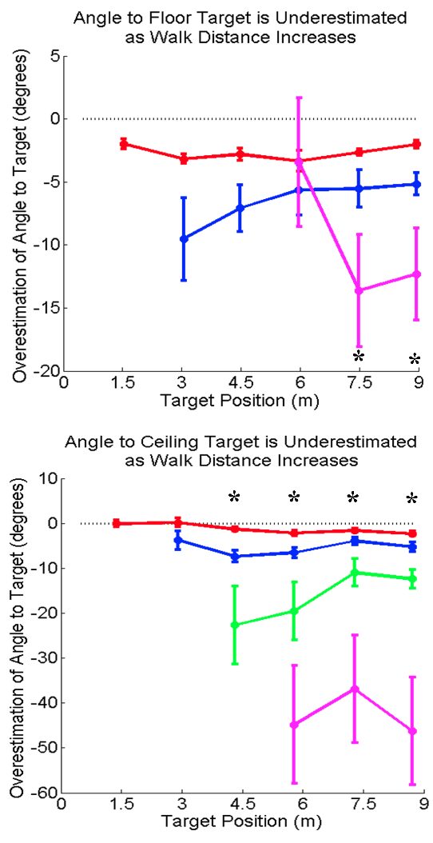
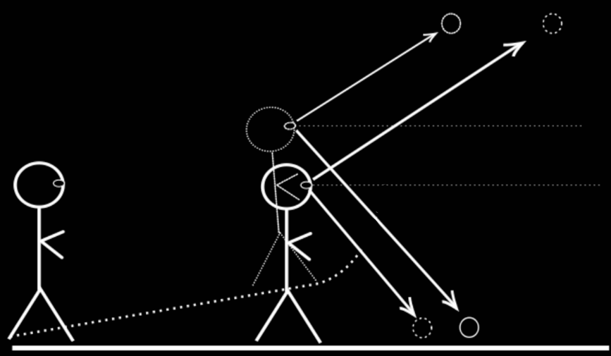
Self-Movement Distance Estimation During Blind Walking
Wilson Lab, Wittenberg University, 2010

Slide 3
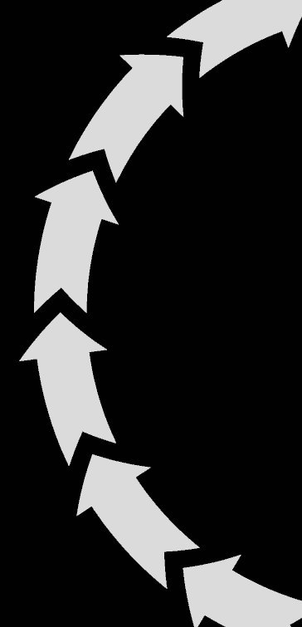
How do our sensory systems take advantage of our ability to act?

Slide 4
What as

Slide 5
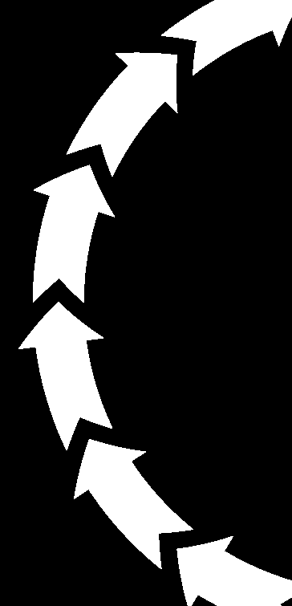
How do our sensory systems take advantage of structured environments?

Slide 6
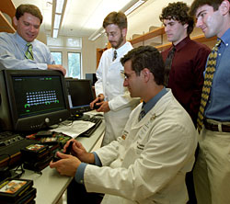
Early
Inspirations
“Teenager moves video icons
just by imagination.”
-Leuthard and Blakely, 2006

Slide 7
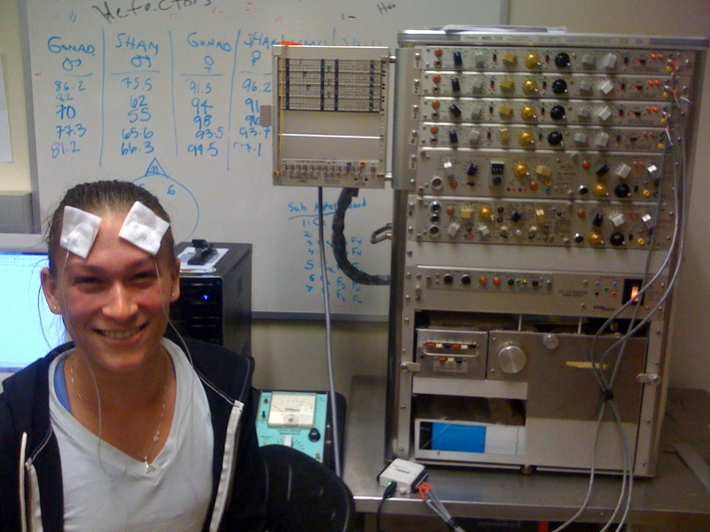
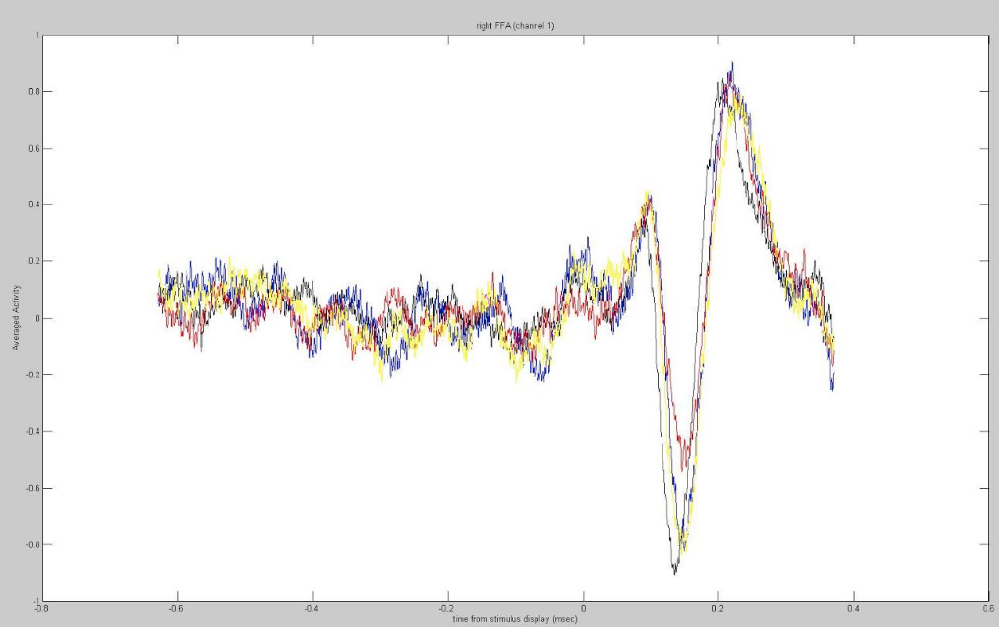
My Bachelor Work: “DIY ERPs: Designing inexpensive EEG systems
for performing auditory and visual cognitive studies.”

Slide 8
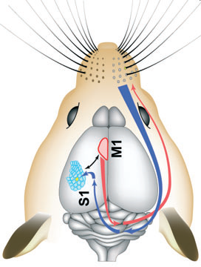
Motor-Modulated Whisker Sensitivity in Barrel Cortex
(Lendvai et al, 2000)
(Aronoff et al, 2010)

Slide 9
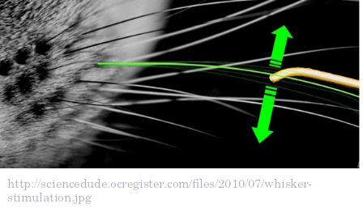
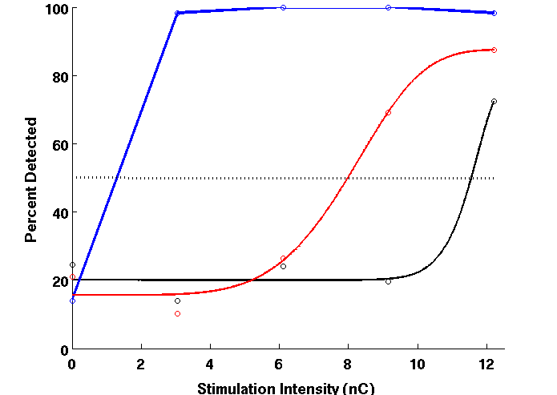
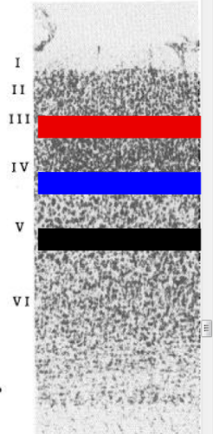
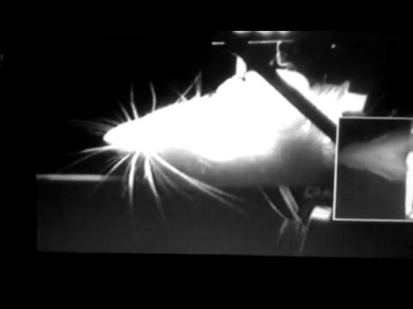
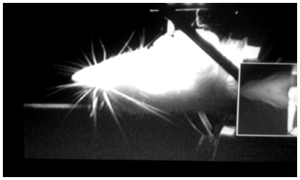
My Lab Rotation: “Layer-Dependent Sensitivity to Electrical Stimulation in Barrel Cortex”
Schwarz Lab, CIN Tübingen

Slide 10
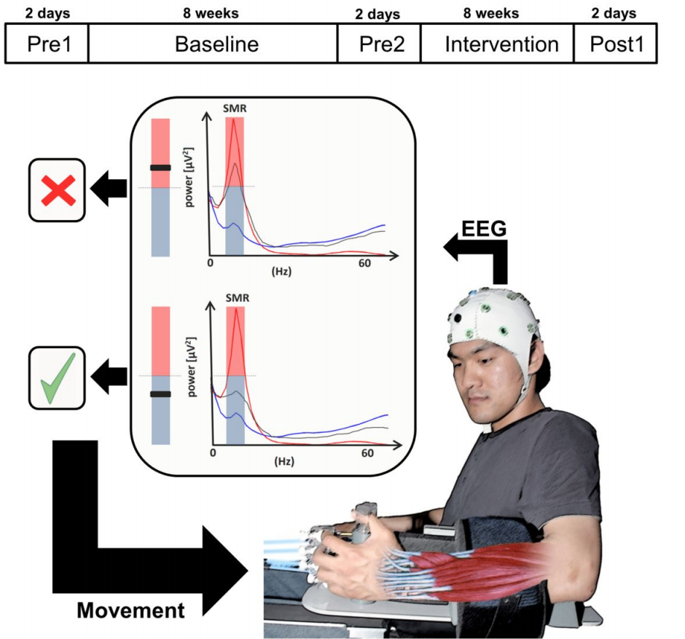
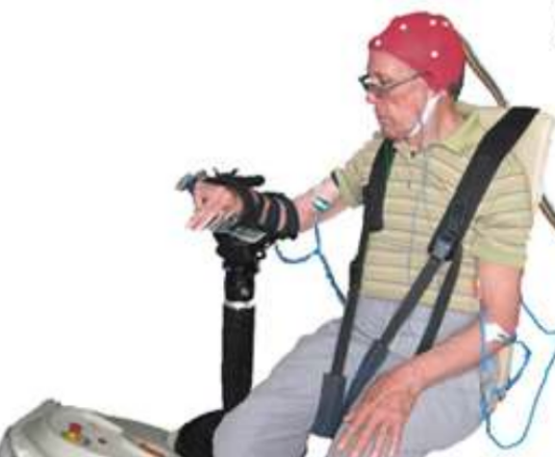
EEG-
Robot
BCI
(Ramos et al, 2014)

Slide 11
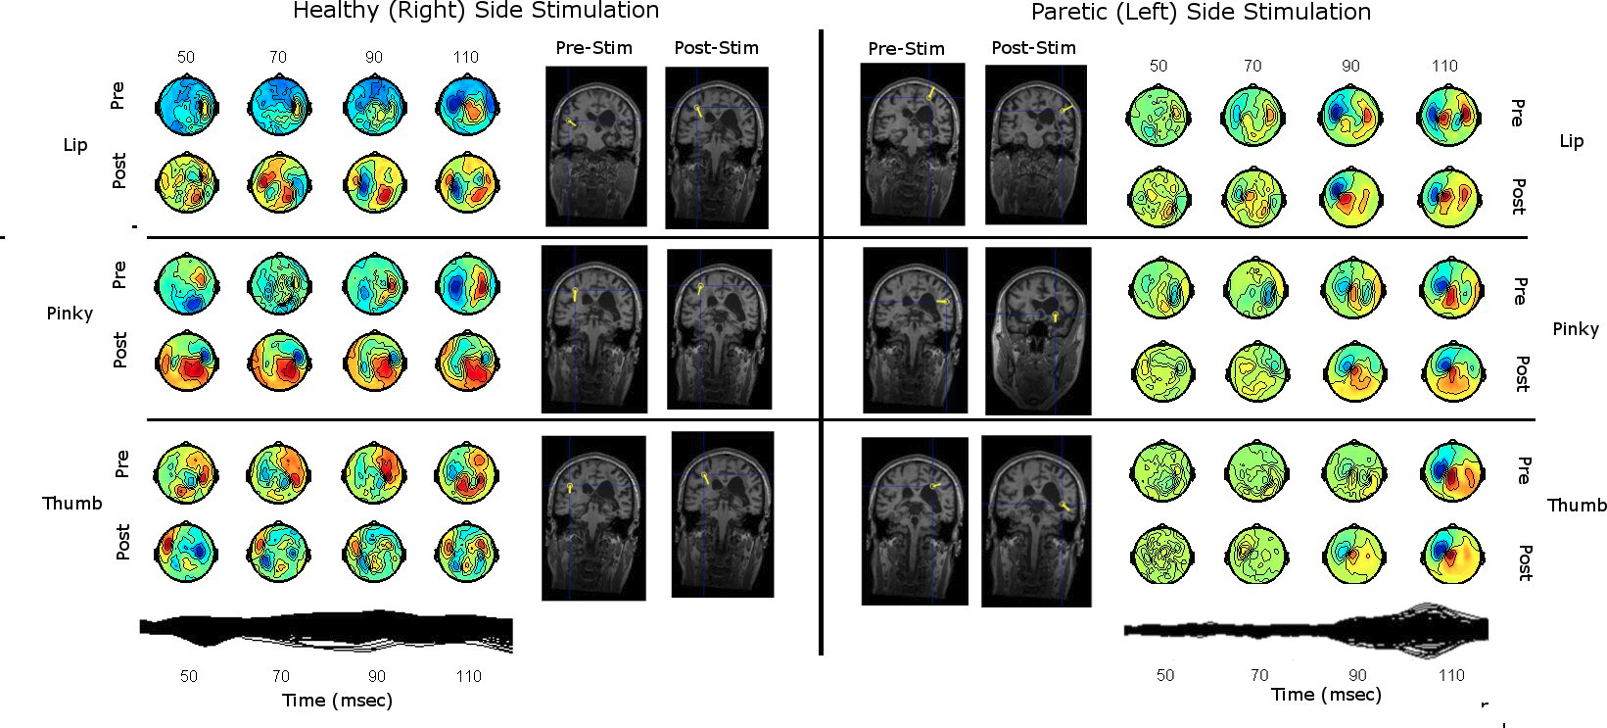
Birbaumer Lab, Dept. of Medical Psychology, Tübingen
My Master’s Thesis: “Neuroplasticity in the Recovering Hemiparetic Stroke Patient”

Slide 12
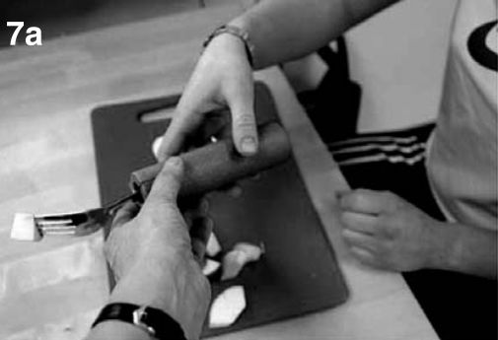
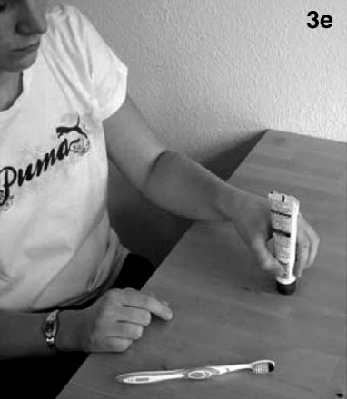
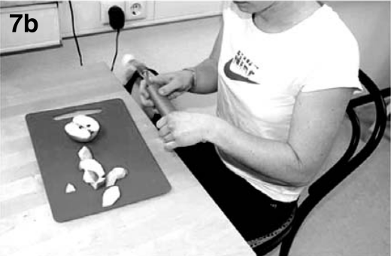
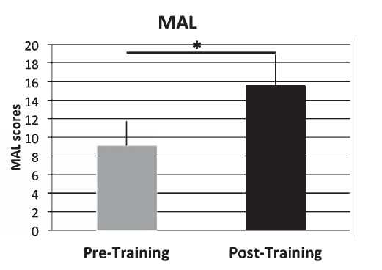
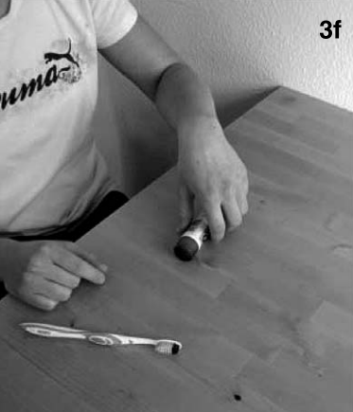
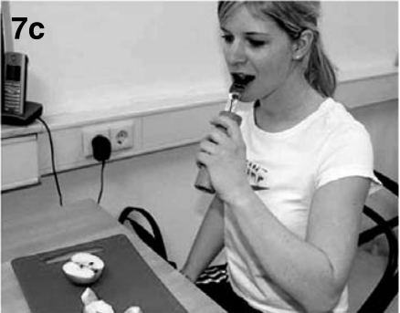
Physiotherapy Enhancement through Rich Experiences
(Broetz et al, 2014)

Slide 13
Starting the PhD

Slide 14
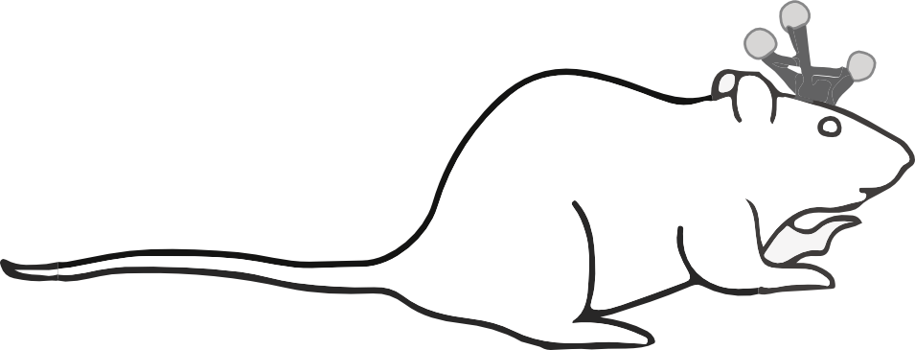
Testing ratCAVE:
A Virtual Reality System for Freely-Moving Rodents
Nicholas A. Del Grosso
Sirota Lab, LMU

Slide 15
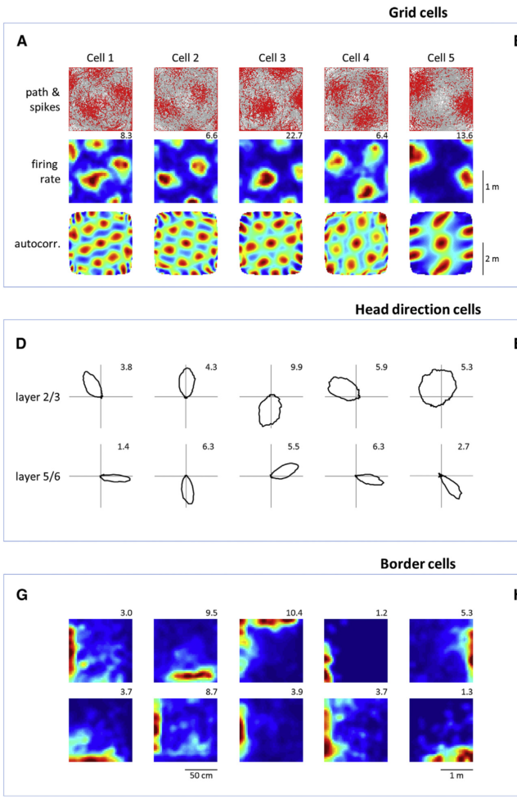
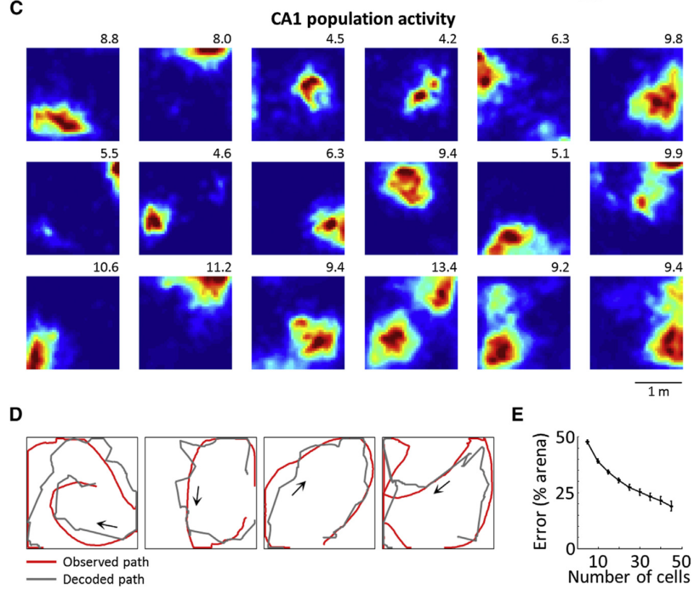
(Aronov & Tank, 2014)

Slide 16
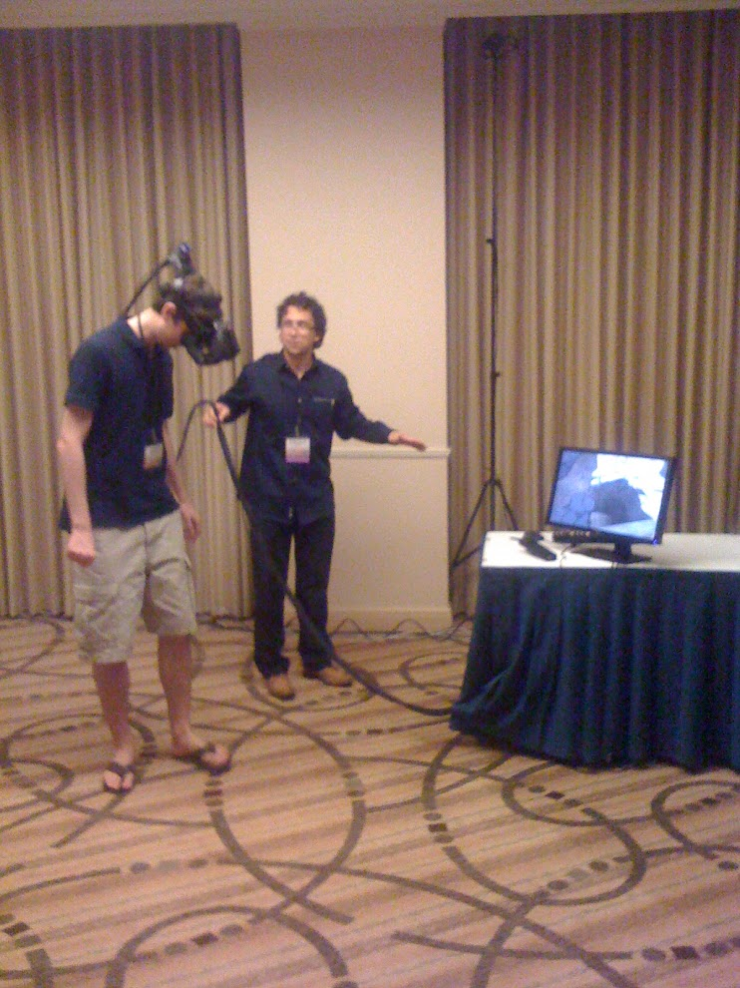
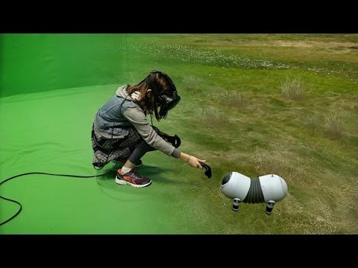
Virtual Reality: Hijacking Navigation-Related Loops

Slide 17
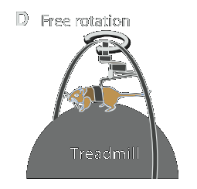
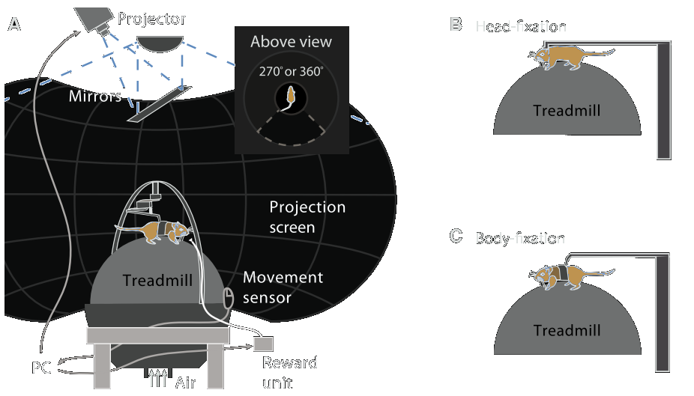
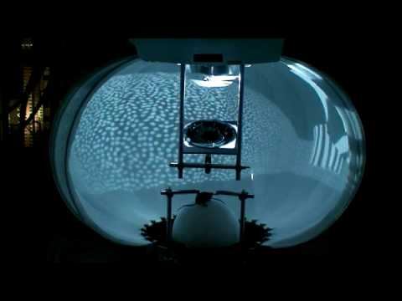
CAVE + Treadmill: The Current State of the Art
(Review: Thurley and Ayaz, 2016)

Slide 18
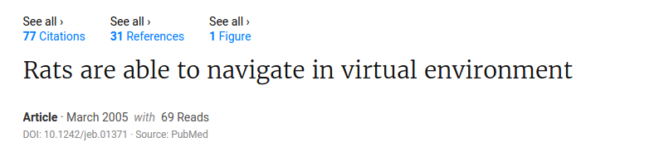
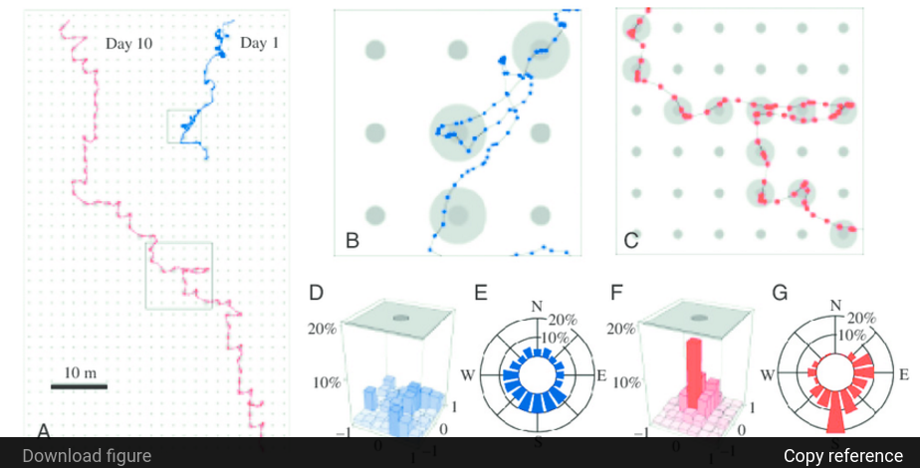

Slide 19
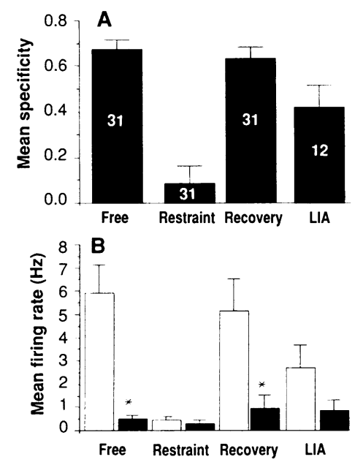
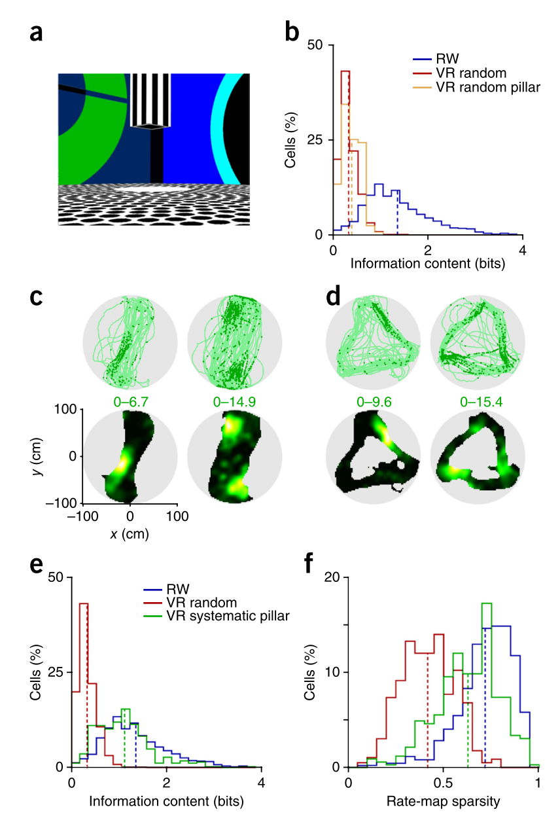
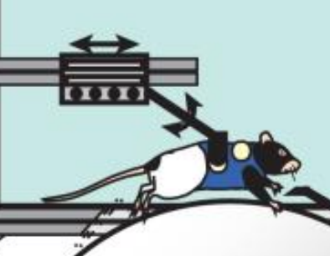
Effects of Body Restriction on Spatial Encoding
(Ravassard et al, 2013; Aghajan et al, 2014)
(Foster, 1989)

Slide 20
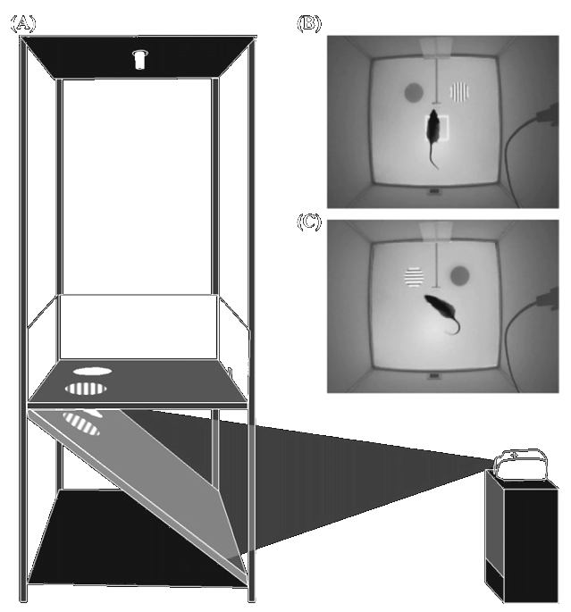
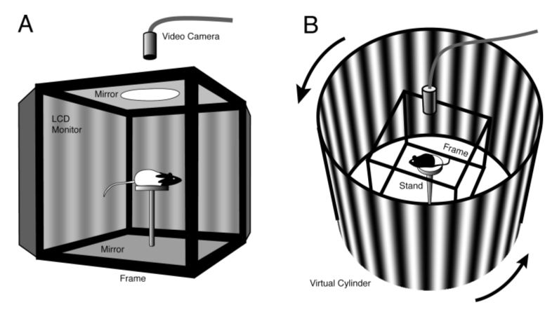
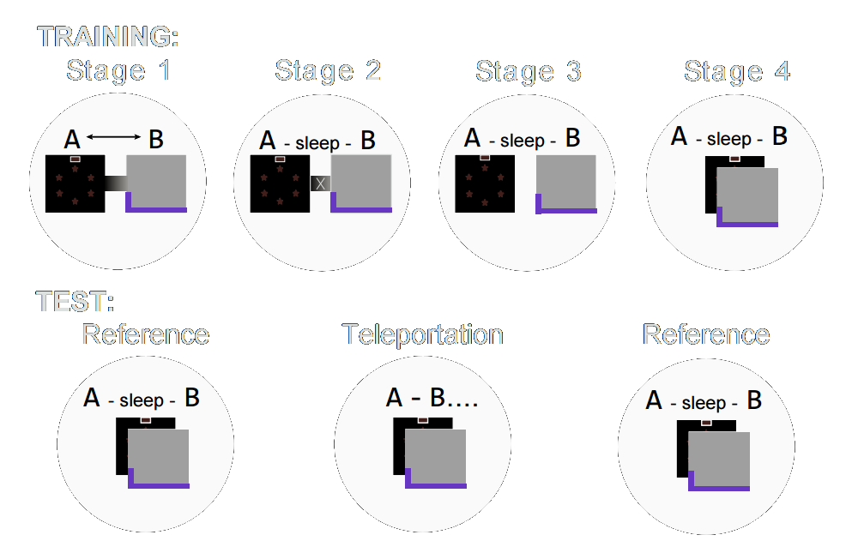
Inspirations: Using VR in Freely-Moving Animals
Operant Conditioning (Furtak et al, 2009)
Visual Acuity Testing (Douglas et al, 2005)
Spatial Cognition Studies (Jezek et al, 20011)

Slide 21
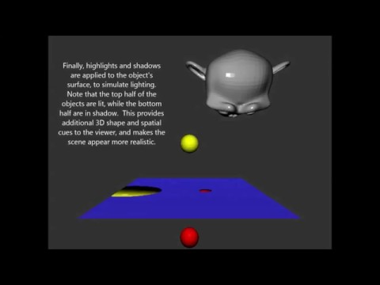
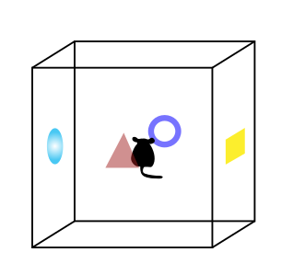
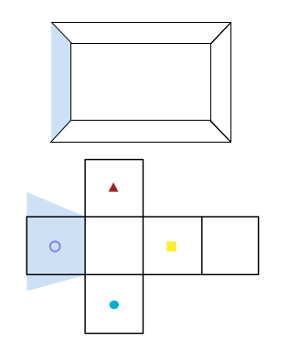
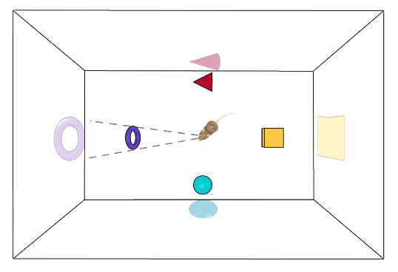
How it’s Done: Mapping 3D Space onto a 2D Surface

Slide 22
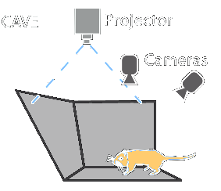
Freely-Moving CAVE: A Simpler Approach

Slide 23
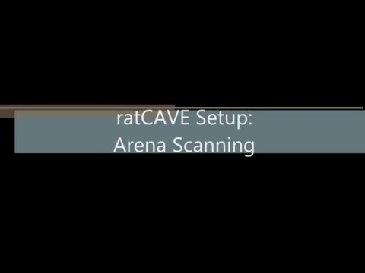

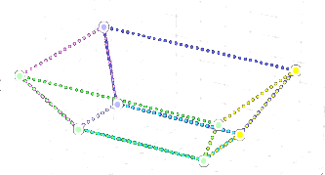
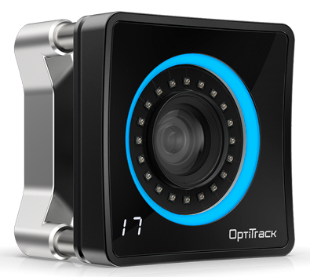
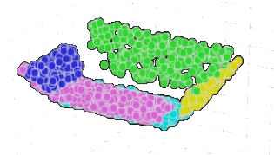

Performing Arena Coregistration with Our Tracking System

Slide 24
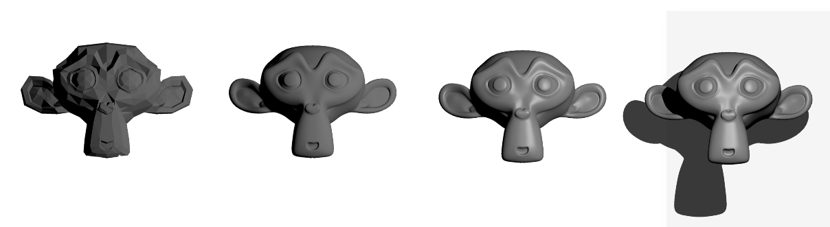
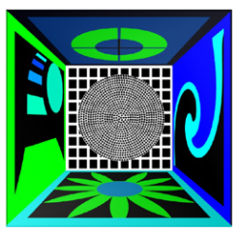
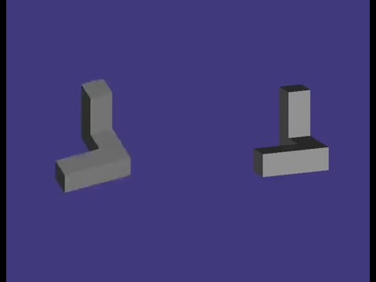

3D VR: Depth Cues from Shadows and Highlights
(Aghajan et al, 2014)
http://pad1.whstatic.com/images/thumb/1/1a/Draw-with-Realistic-Shading-Step-3.jpg/aid32150-v4-728px-Draw-with-Realistic-Shading-Step-3.jpg

Slide 25


(Ratcave is also an Open-Source 3D Graphics Package for Python!)

Slide 26

The ratCAVE VR Setup
Notes:
1

Slide 27

And?
How Do the Rats React to the ratCAVE?

Slide 28



Experiment 1: Virtual Cliff Avoidance

Slide 29


Different Stimulus Conditions

Slide 30


Cliff Avoidance Experiment: Preliminary Results

Slide 31


Experiment 2: Virtual Wall Avoidance

Slide 32



Result: Rats Explored the Virtual Wall

Slide 33




Virtual Object Exploration
1
2
3

Slide 34


Experiment 3b: Virtual Object Exploration
***
***
***
***

Slide 35


Slide 36




Experiment 4: Virtual Arena Translation

Slide 37


The Virtual Arena Shift Effect Wore Off Over Sessions

Slide 38
Conclusions
Motion Parallax Stimuli helps Rats Avoid Visual Cliffs
Rats Are Attracted to Virtual Objects
Rats’ Hippocampal Place Cell Map Can Be Locked to Virtual Environments
Rats Can Ignore Virtual Environments Spatial Cues.

Slide 39


Future Directions
Role of Motion Parallax and Other Visual Cues During Self Motion for Depth Perception
Effect of Vestibular Stimulation on Path Integration

Slide 40
Lessons Learned

Slide 41

Many Thanks to My Supervisor:
Prof. Dr. Anton Sirota
Also Thanks to Co-Authors and Collaborators:
Eduardo Blanco-Hernández
Justin J. Graboski
Weiwei Chen
Nico Kuske (MotivePy)
Rizwan Ahmed
Thank You for Your Attention!

